Slide 1

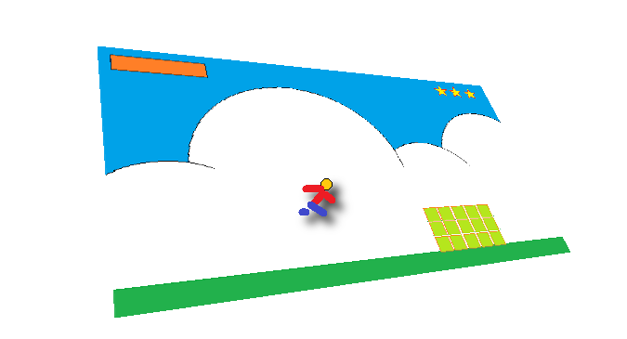
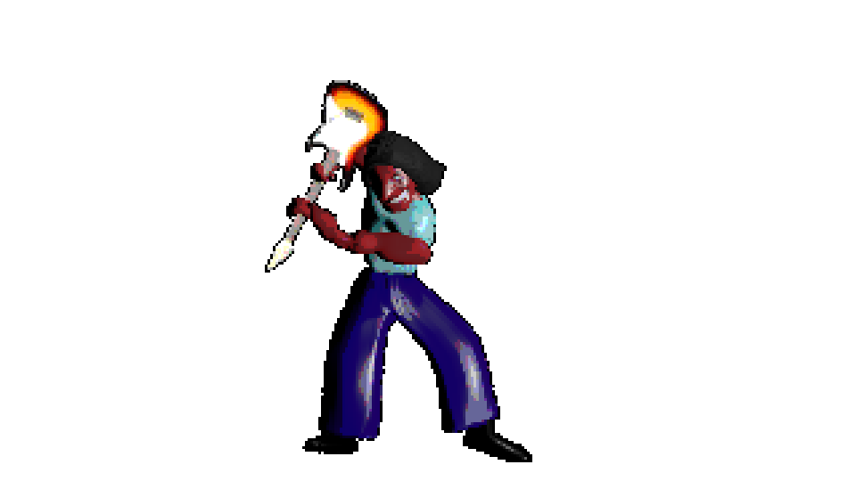
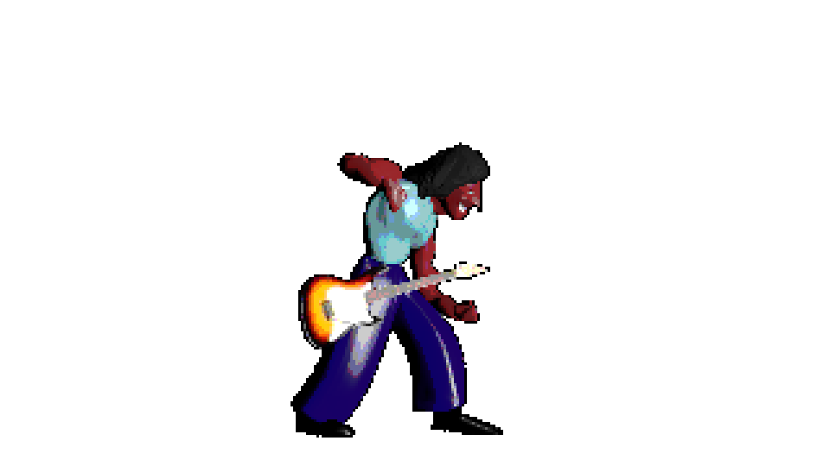
Using smartSpriteFX
Version Alpha 2.0
© 2016 - Atelier do Software
Developed by MGODOY

Slide 2
What’s smartSpriteFX?
smartSpriteFX is a component from open-source software suite smartSuite, that groups free simple solutions for developers of indie-games have their life easier, spending less time in activities that normally would take several hours or even require a bigger team.
Know more in https://www.facebook.com/smartsuiteforindiegame/

Slide 3
What we can wait from this version?
That´s a Alpha version, that means which it isn’t a definitive version yet. You may find some bugs and several tools still aren’t available.
Stay in tune in https://www.facebook.com/smartsuiteforindiegame/ or in CodePlex download page to be aware about releases.

Slide 4
Installation
First of all, choose a folder to host smartSpriteFX. Before open it at first time, check the requirements that your computer needs to have:
Windows 64 bit
Microsoft .NET Framework 4.5.2 installed
Unzip smartSpriteFX.zip in some folder. You are going to see several files. Just execute “smartSpriteFX.exe”.

Slide 5
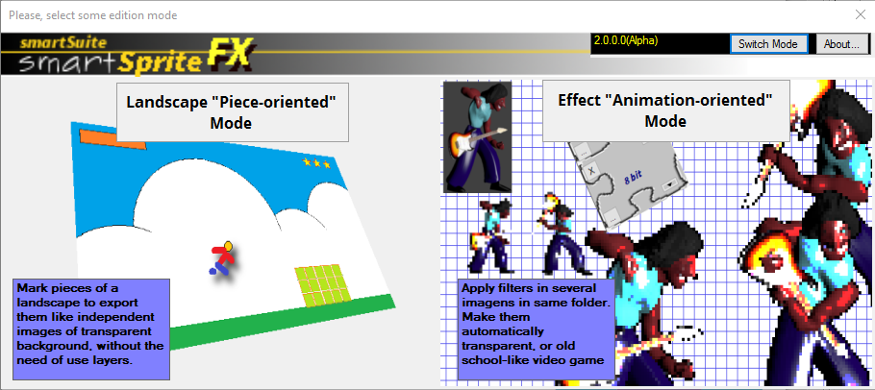
The Main Screen / Switch Mode
You can return to Switch Mode whenever you want, just clicking in shortcut in top of screen.
SmartSpriteFX has the main screen called “Switch Mode”. Here, you can choose one of two modes:
Landscape “Piece-oriented” mode
Effect “Animation-oriented” mode

Slide 6
Landscape “Piece-oriented” mode (resume to slide 7)
Piece-oriented mode it is all about cut pieces of an image, normally a draft and create new images from it in an organized way.
Piece-oriented mode was intended to support you to think an image like a big scene and the pieces like 2D Game Objects in Unity Game Framework, provide you automatically made transparent backgrounds in which of these pieces without lead with masks and layers
Effect “Animation-oriented” mode (go to slide 14)
The Animation-oriented mode brings to you the ability to apply in several images at once a couple of filters which are added each other to produce one single result per image. Among them:
Transform images in a 8 bit video-game style
Work with images of characters adding automatically a transparent background, or even drawing a shading around them, without point anything.
The Animation-oriented mode was intended to support Blender 3D artists interested in transform their animations, generated in pictures, in 2D aspect to use in Unity Game Framework, like pre-rendered images – like games like “Donkey-Kong Country” or even traditional 2D animation, like Strider or Ghouls and Ghosts

Slide 7
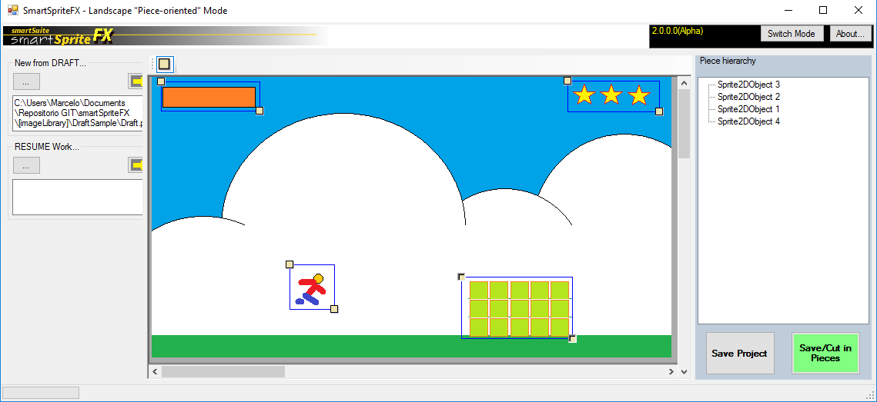
Landscape “Piece-oriented” mode
Anchor ON/OFF
Opens new draft
Shortcut menu
Piece hierarchy tree
Resumes the project
Commands
Draft

Slide 8
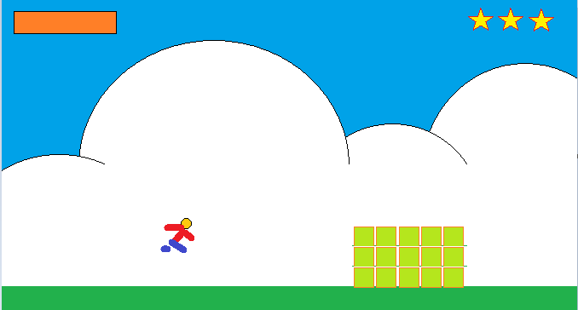
Prepare you draft
Prepare your draft anyway you want. I have created this in Paint Brush. You should include all detail that you want to have in your screen.

Slide 9
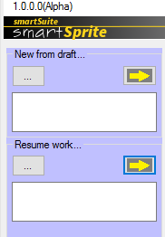

2) Start from draft
Create a new project using the draft created. Use “New from draft”
Save Project when you want to save to resume later.
Resume work when you want to resume again
To generate pieces to use in your game, use Save/Cut in Pieces.

Slide 10

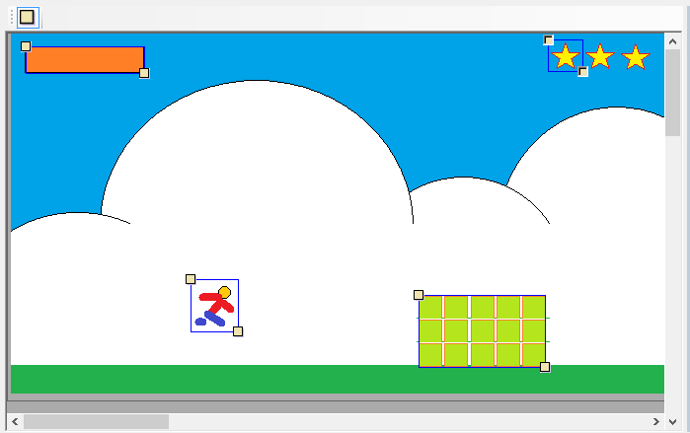
3) Indicate pieces
We call the little square in top of draft screen of “hook”. Use hooks to mark the pieces. See the pieces like a GameObject in Unity. Mark as many piece as the game object that you are planning to interact.
The system to mark them is based on hypotenuses. You just need mark the opposite points.
Do not forget to Save Project.

Slide 11
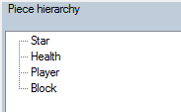
4) Organize yourself
A good tip is give name to objects. Use Piece hierarchy to provide them. Press F2 to change some name.
If you regret for create some object you can undo this remove it. Discover the object, marke it and press DELETE key.
Remember: don’t forget to Save Project after any changes!!!!

Slide 12
5) Save/Cut in Pieces
When like to export the pieces to use like GameObject in Unity, use Save/Cut in Pieces.
During the process, smartSpriteFX can have some doubts about the decision about the background in pieces. So, stay in touch during this process, because I can ask you something.

Slide 13
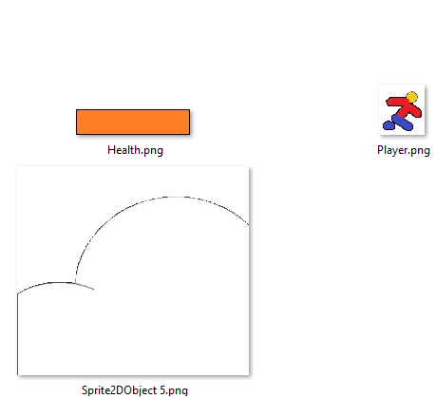
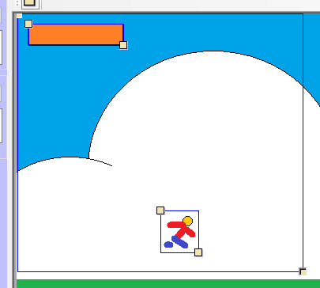
Pieces can be created inside of others
When this happens, smartSpriteFX will overcover the space without the pieces!!

Slide 14
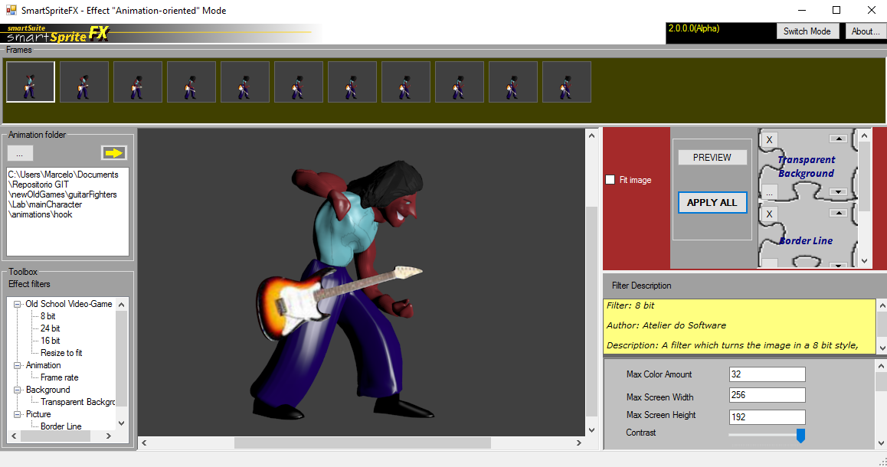
Effect “Animation-oriented” mode
Fits frame in preview board
Shortcut menu
Frames
Selected filters and commands to preview and apply filters
Opens the animation folder
Filter pallet
Preview board
Filter configuration panel

Slide 15
1) Prepare your animation
In smartSpriteFX, an animation is a folder contained several images. For practical reason, we starting to call them frames.
The frames doesn't need to refer each other.
You can create them anyway you want. Here, we create them in Blender from animation in 3D.
Blender is a 3D open-source software developed by Blender Foudation.

Slide 16
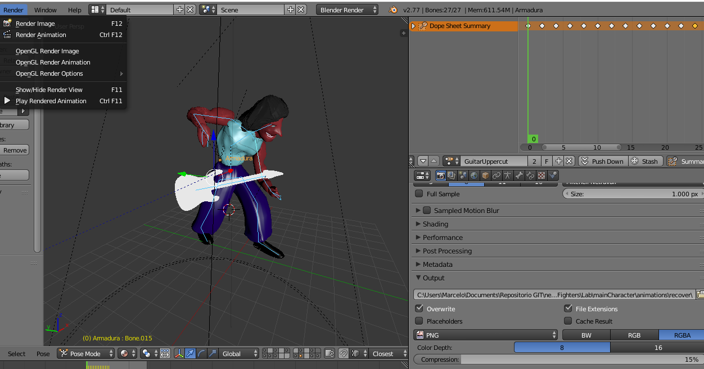
Quick explanation about Animation in Blender...
In Render menu, you can Render animation. That is the last thing that you are going to do
The moves (position of bones) can be grouped like “Actions”, Here you have a time line
You create objects and skeletons (called “armature”). You move the bones around the axis along the key frames to create animation
This menu you configure the output folder. Here you chose “PNG” like output. Memorize that folder, because you are going to use in smartSpriteFX.

Slide 17
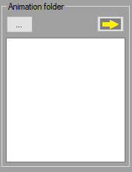
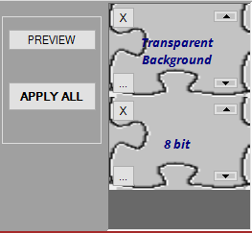
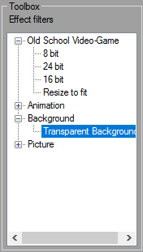
2) Proceed to smartSpriteFX and choose “Animation-oriented” mode
Select the folder which contains the images
After that, note the Toolbox/Effect filters. It will have filled with filters. Open a group and give a double-click over it to select a filter that you desire.
Note the right panel. The selected filters will show up. You can remove them if you want.

Slide 18
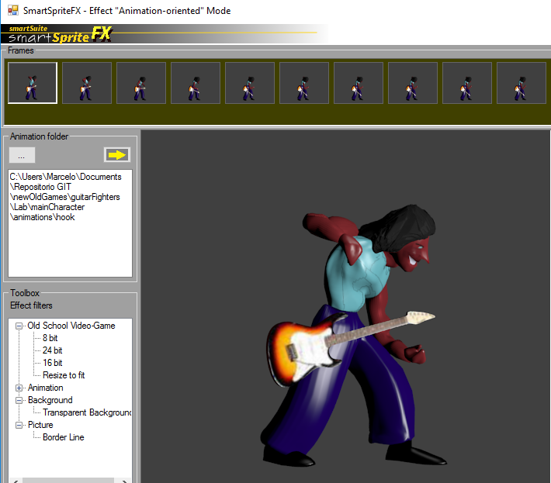
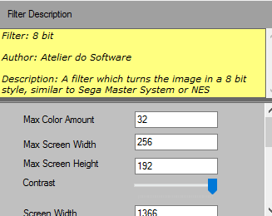
3) Select a frame, configure filters,and...
Change the filter order. This can complete change the result
You can see a summary about the function of filter and configure some attributes, according to the filter

Slide 19
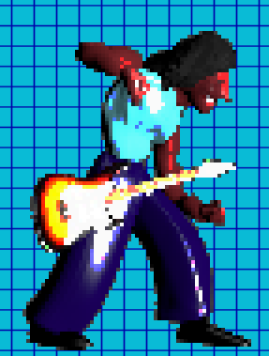
4) … preview the result

Slide 20
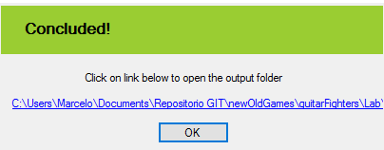
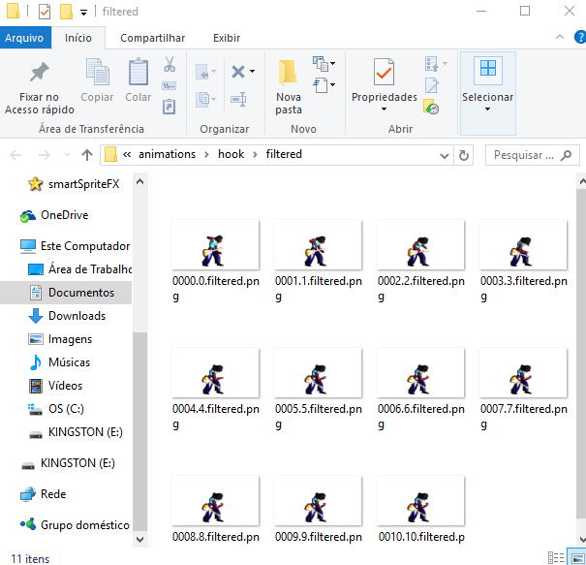
5) Apply over the entire animation!
Wait for conclusion. Click over the link
Apply the filters
See the new images!!

Slide 21
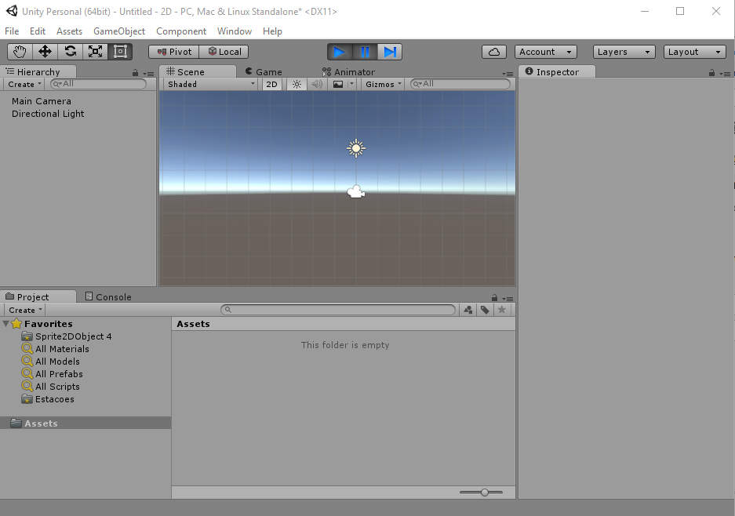
6) Import the filtered images to Unity
1) Create a 2D Unity project
2) Drag and drop all the filtered images to some Asset folder in Unity

Slide 22
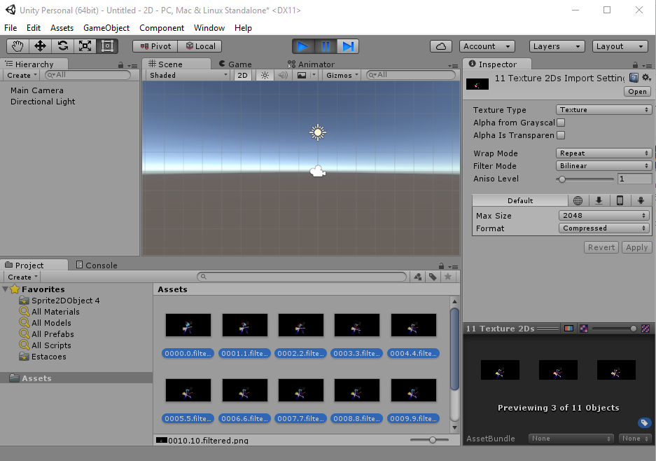
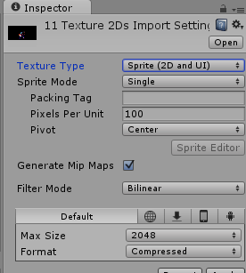
7) Signs all the images to Sprite (2D and UI)

Slide 23
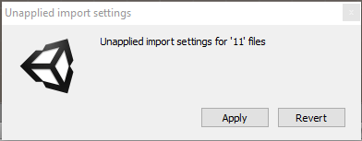
8) Click in assets and confirm import settings
Click in any place in asset folder to see the question.
Confirm “Apply” and wait

Slide 24
8) Click in assets and confirm import settings
Click in any place in asset folder to see the question.
Confirm “Apply” and wait

Slide 25
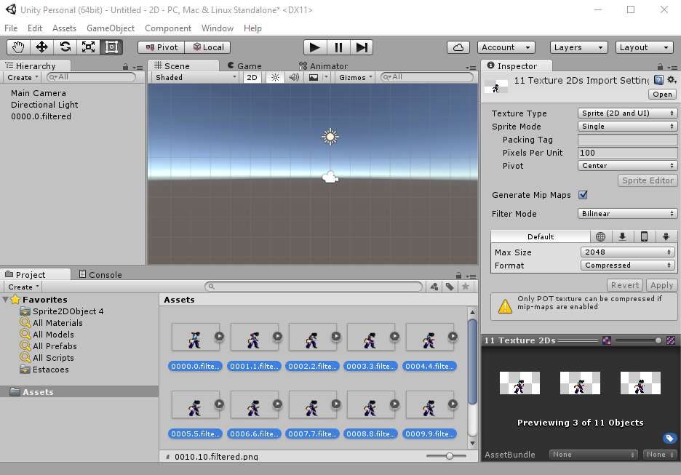
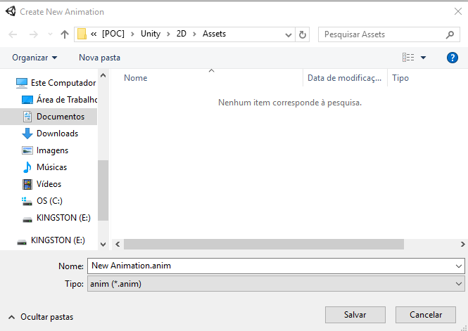
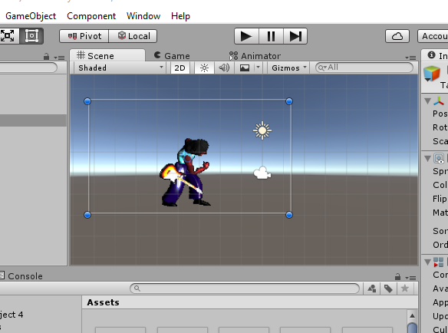

9) Select all images and drag and drop to scene
Drag and drop all images to scene
Save animation
Play to see the animation!!!!

Slide 26
Appendix – Going further in effect
Effect filters can be incremented with new effects.
Official and third-party effects can be added. You also can create you own effects if you had ability in programming.
Third-part effects should be placed in ThirdPartyEffectModulePlugin folder.
The documentation to explain how to implement new effects will be available soon.

Slide 27
Be aware of news:
https://m.facebook.com/smartsuiteforindiegame/
Blender, Unity, Visual Studio and C#, Donkey Kong Country, NES / SNES, Nintendo, Sega Master System and Sega Genesis are trademark of their respective owners.

